Slide 2
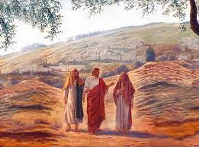
Dwelling
Between
Heaven and Earth

Slide 3
Jesus said to them, “what are you discussing with each other while you walk along?” They stood still, looking sad.

Slide 4
Then one of them, whose name was Cleopas, answered him, “are you the only stranger in Jerusalem who does not know the things that have taken place there in these days?” Jesus asked them,

Slide 5
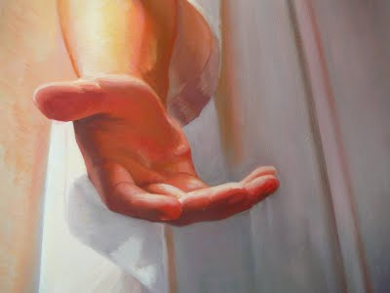
“what things?”

Slide 6
They replied, “The things about Jesus of Nazareth, who was a prophet mighty in deed and word before God and all the people, and how our chief priests and leaders handed him over to be condemned to death and crucified him. But we had hoped that he was the one to redeem Israel. Yes, and besides all this, it is now the third day since these things took place.”

Slide 7
“Moreover, some women of our group astounded us. They were at the tomb early this morning, and when they did not find his body there, they came back and told us that they had indeed seen a vision of angels who said that he was alive. Some of those who were with us went to the tomb and found it just as the women had said; but they did not see him.”

Slide 8
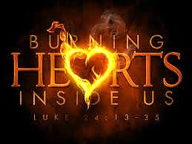

Slide 10
Discernment of Spirits St. Ignatius of Loyola
Good Spirits lead me in a positive direction towards a good goal (first birth truth).
Counter Spirits make use of negative directions (second birth illusions), and even sometimes of what are at first good directions, to take us away from the truth of the Divine Indwelling.

Slide 11
The action of good or counter spirits result in "movements” that occur within one's heart (or soul), we notice our spirit is lifted to God (first birth), or is down, losing interest in God (second birth unfulfillment).
The words "good" and “counter" as applied to "spirits" mean the source of the movement, the direction it takes us, and the sense it leaves us with.

Slide 12
Direction of the
counter spirit
Direction of the
good spirit

Slide 13
Good spirit resonates in my immaturity as an uneasiness grows in me, or remorse sets in, so that I am moved to change.
Counter spirit resonates in my immaturity as an complacency, or promise of pleasure, so there is no will to change direction of my life.

Slide 14
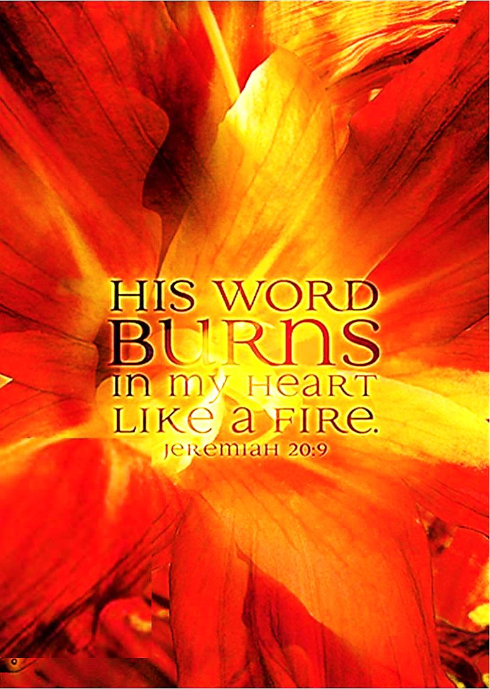

Slide 15
Good spirit resonates in my maturity as it strengthens, encourages, consoles, inspires, brings peace, conviction, and continues my progress in the Lord.
Counter spirit resonates in my maturity as it brings discouragement and deception to deter me from growing in the Christ‑life.

Slide 17
With the action of the Good Spirit
One grows in awareness of patterns in life that lead away from a loving benevolent God
One notices moments of freedom that come when I am not a slave to such patterns (sinfulness)
One becomes less self-focused and oriented towards a greater trust in the benevolence of God in their lives

Slide 18
“Were not our hearts burning within us AS he talked to us on the road, and opened the scriptures to us?” Luke 24:13-35

Slide 19
First Principle & Foundation St. Ignatius of Loyola
I am created to praise, reverence, and serve God
All other things … are created to help me attain this end
All things that are a hindrance to this end should be avoided
I need to become indifferent to all things save God alone

Slide 20
Luke 12:33-34
“Where your treasure is there will be your heart also”

Slide 21
