Slide 2
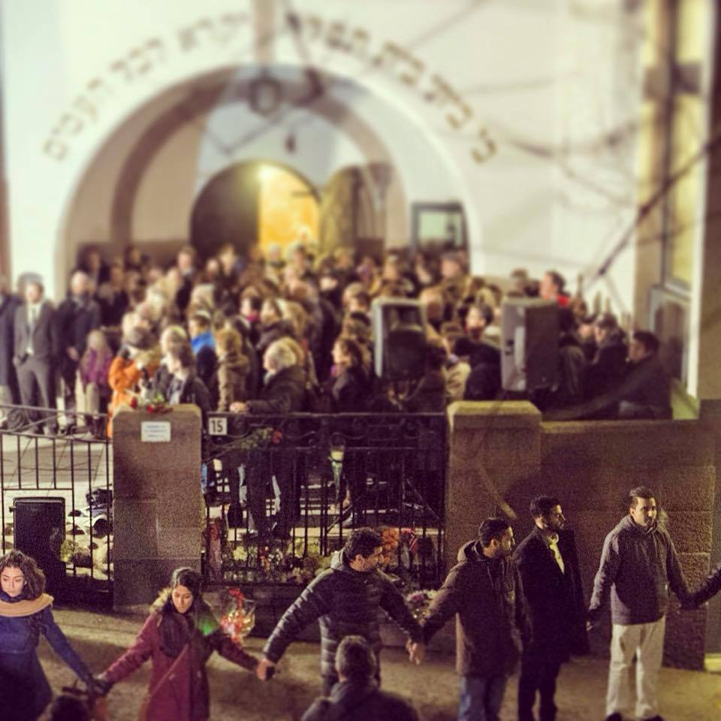
Dwelling
in the Space
Between
Heaven and Earth

Slide 3
Your soul knows the geography of your destiny. Your soul alone has the map of your future, therefore you can trust this indirect, oblique side of yourself.
If you do, it will take you where you need to go, but more important it will teach you a kindness of rhythm in your journey.
John O'Donohue, Anam Cara: A Book of Celtic Wisdom

Slide 4
Enoughness
And
Abundance

Slide 5
"Earth's crammed with heaven,
and every common bush
afire with God. But only he who sees
takes off his shoes."
Elizabeth Barrett Browning

Slide 6
A World of
Engaged
Contemplatives

Slide 7
In 1993 a national demonstration project conducted in Washington, D.C., by a
coherence-creating group of meditators
reduced serious crime by 23% over four weeks

Slide 8
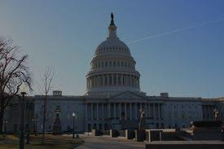
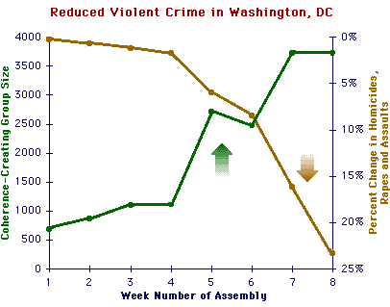

Slide 9
Widening
our Circle of
Compassion

Slide 10
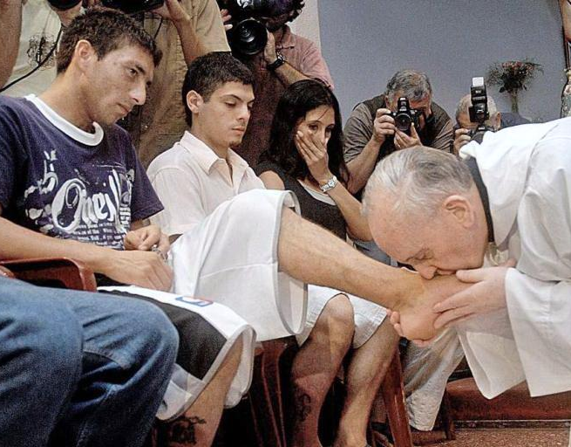
Pope Francis washes the feet of wo women and two Muslims at Juvenile detention centre Rome Easter 2013

Slide 11
Muslim ‘Peace Circle’ Surrounds Norwegian
Synagogue, Copenhagen Feb, 2015

Slide 12
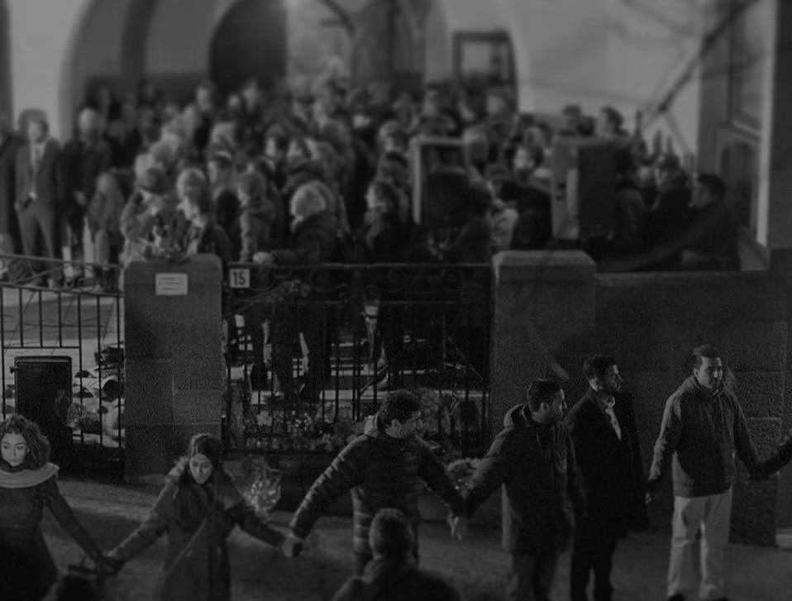
Thirty-seven-year-old Zeeshan Abdullah, one of the organizers, told the crowd. “This shows that there are many more peacemakers than war-makers. There is still hope
for humanity, for peace and love across
religious differences and background.”
The chief rabbi of Norway looked
visibly moved by the gesture.

Slide 13
Ecological
Conversion
(Blessed John Paul II, Jan 2001)

Slide 14
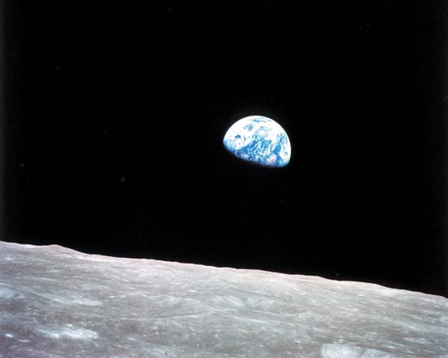
‘Earthrise’ – first photograph of Earth from the moon
taken by astronaut William Anders (1968)

Slide 15
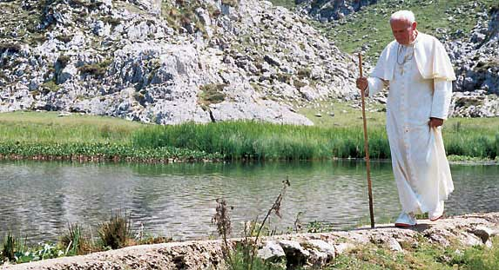
"We are losing our attitude of wonder, of contemplation, of listening to creation and thus we no longer manage to interpret within it what Benedict XVI calls 'the rhythm of the love-story between God and man.'"
+ Pope Francis

Slide 16
Where do you see
the Mystery
“burning”
in our world today?
http://abundance.org.au

